Slide 1
Forensic Video
Workflow Challenges and Strategies
Gareth Harbord, Senior Digital Forensic Specialist, MPS Video Laboratory
Gareth.Harbord@met.police.uk
Notes:
Hi. I’m Gareth Harbord.
I head up a video data recovery team for the London Metropolitan Police Service.
The video laboratory is responsible for the forensic processing and analysis of video evidence
I started off in 2005, doing various technical broadcast jobs till around 9 years ago when I moved over to forensics.
This talk will be exploring some of the approaches we take to preserve image quality whilst processing video.
We will also look at the limitations we face and strategies to mitigate those limitations.

Slide 2
Introduction
Forensic Science - Applying scientific principles and techniques whilst collecting, examining and analysing evidence.
Results should be reliable, repeatable, verifiable.
Notes:
Forensic Science:
Collecting / Examining / Analysing - Evidence
Results should be:
Reliable
Repeatable
Verifiable

Slide 3
Introduction
Reliability – Can we trust the results?
Repeatability – Will the same test get the same result?
Verifiability – Can the results be checked?
Notes:
Reliability – Can we trust the results
Repeatablility – Will the same test get the same result?
Verifiability – Can the results be checked and confirmed?

Slide 4
Contents
End State
Video Lab Overview
Diversity of Source and Format
Quantity Not Quality
Acquisition
Ingest
Notes:
Bullet points
End State – Goals of the work
Overview – What we do in the lab
Diversity of source – A look at the different media sources that need processing
Quantity not quality – So much data!
Acquisition – How we get at the data?
Ingest – Getting the data into a workable state…
Compilation – Considerations when editing so much mixed media
Presentation – What happens when the work is done

Slide 5
End State – What is it all for?
Gareth.Harbord@met.police.uk

Slide 6
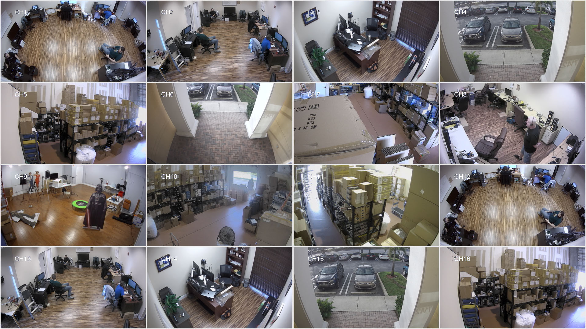
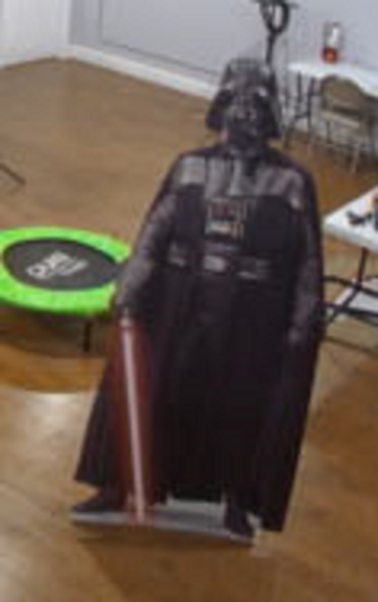
End State
Live Intelligence e.g. tracking a missing person
Notes:
Video footage is immediately required.
Cannot be viewed but must be seen urgently.
Usually essential for identifying a suspect or finding a missing person

Slide 7
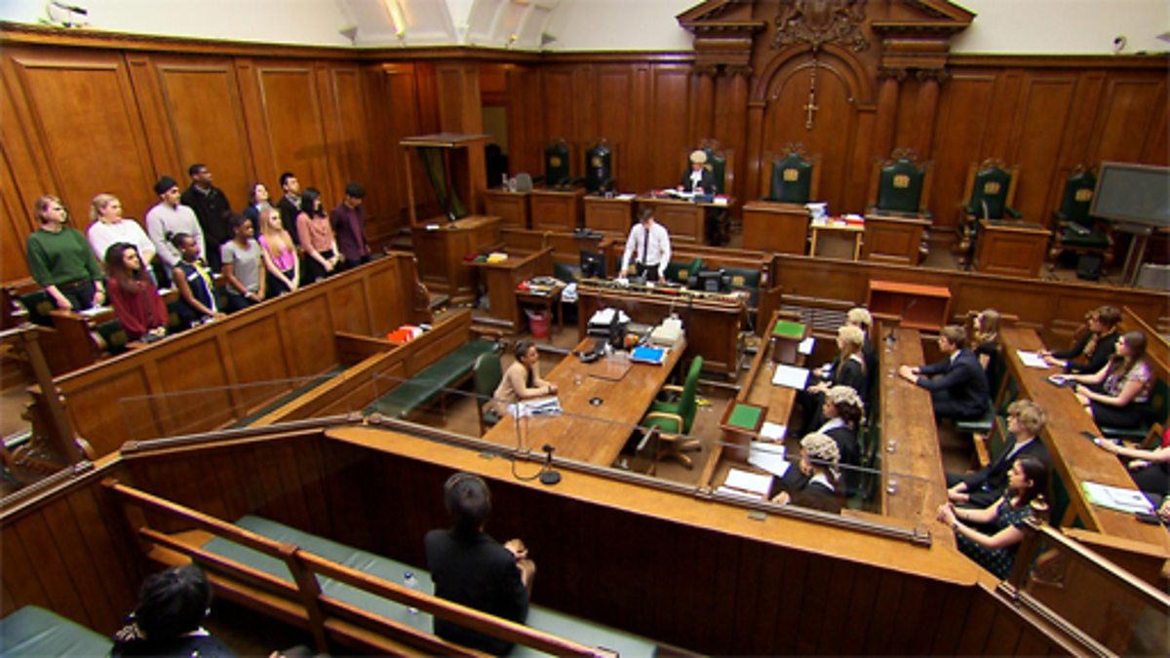
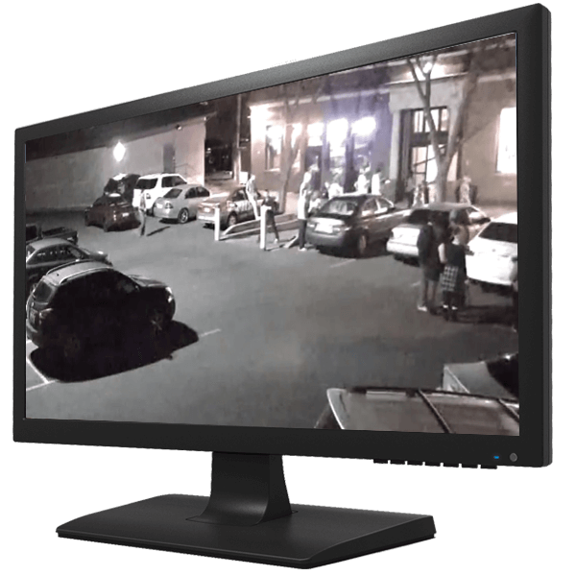
End State
Evidential – Presentation in Court
Notes:
In this situation the video must be prepared for viewing in court.
We will discuss this in more detail later

Slide 8
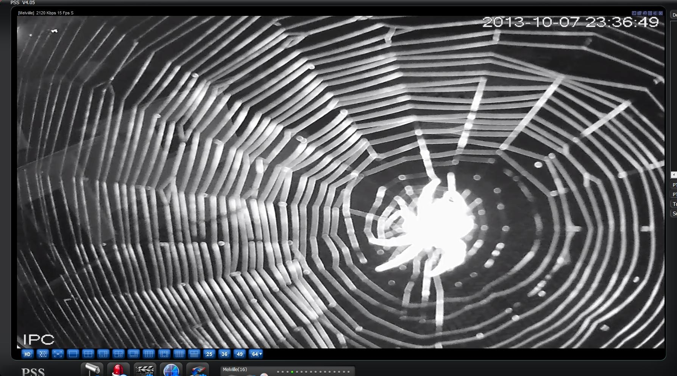
End State
No Further Action
Notes:
Nothing useful found, no further work
e.g. 8 hrs of infrared lit spiderweb
OR
Unrecoverable
OR
Not there

Slide 9
Video Laboratory Overview
Gareth.Harbord@met.police.uk

Slide 10
Video Laboratory Overview
Downloads and Data Recovery
Court Compilation/Presentation
Enhancement
Comparison
Notes:
Bullet points
This is a quick look at different functions within the lab

Slide 11
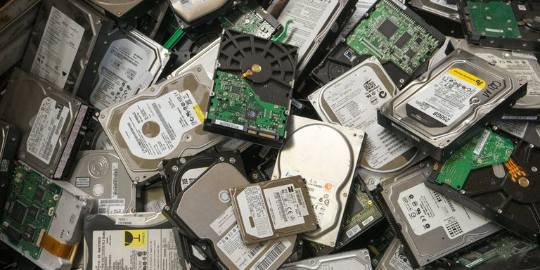
Video Laboratory Overview
Downloads and Data Recovery
Notes:
Data Acquisition from a variety of source devices
Different systems are triaged
Physical damage assessed
Logical data issues escalated if proportional

Slide 12
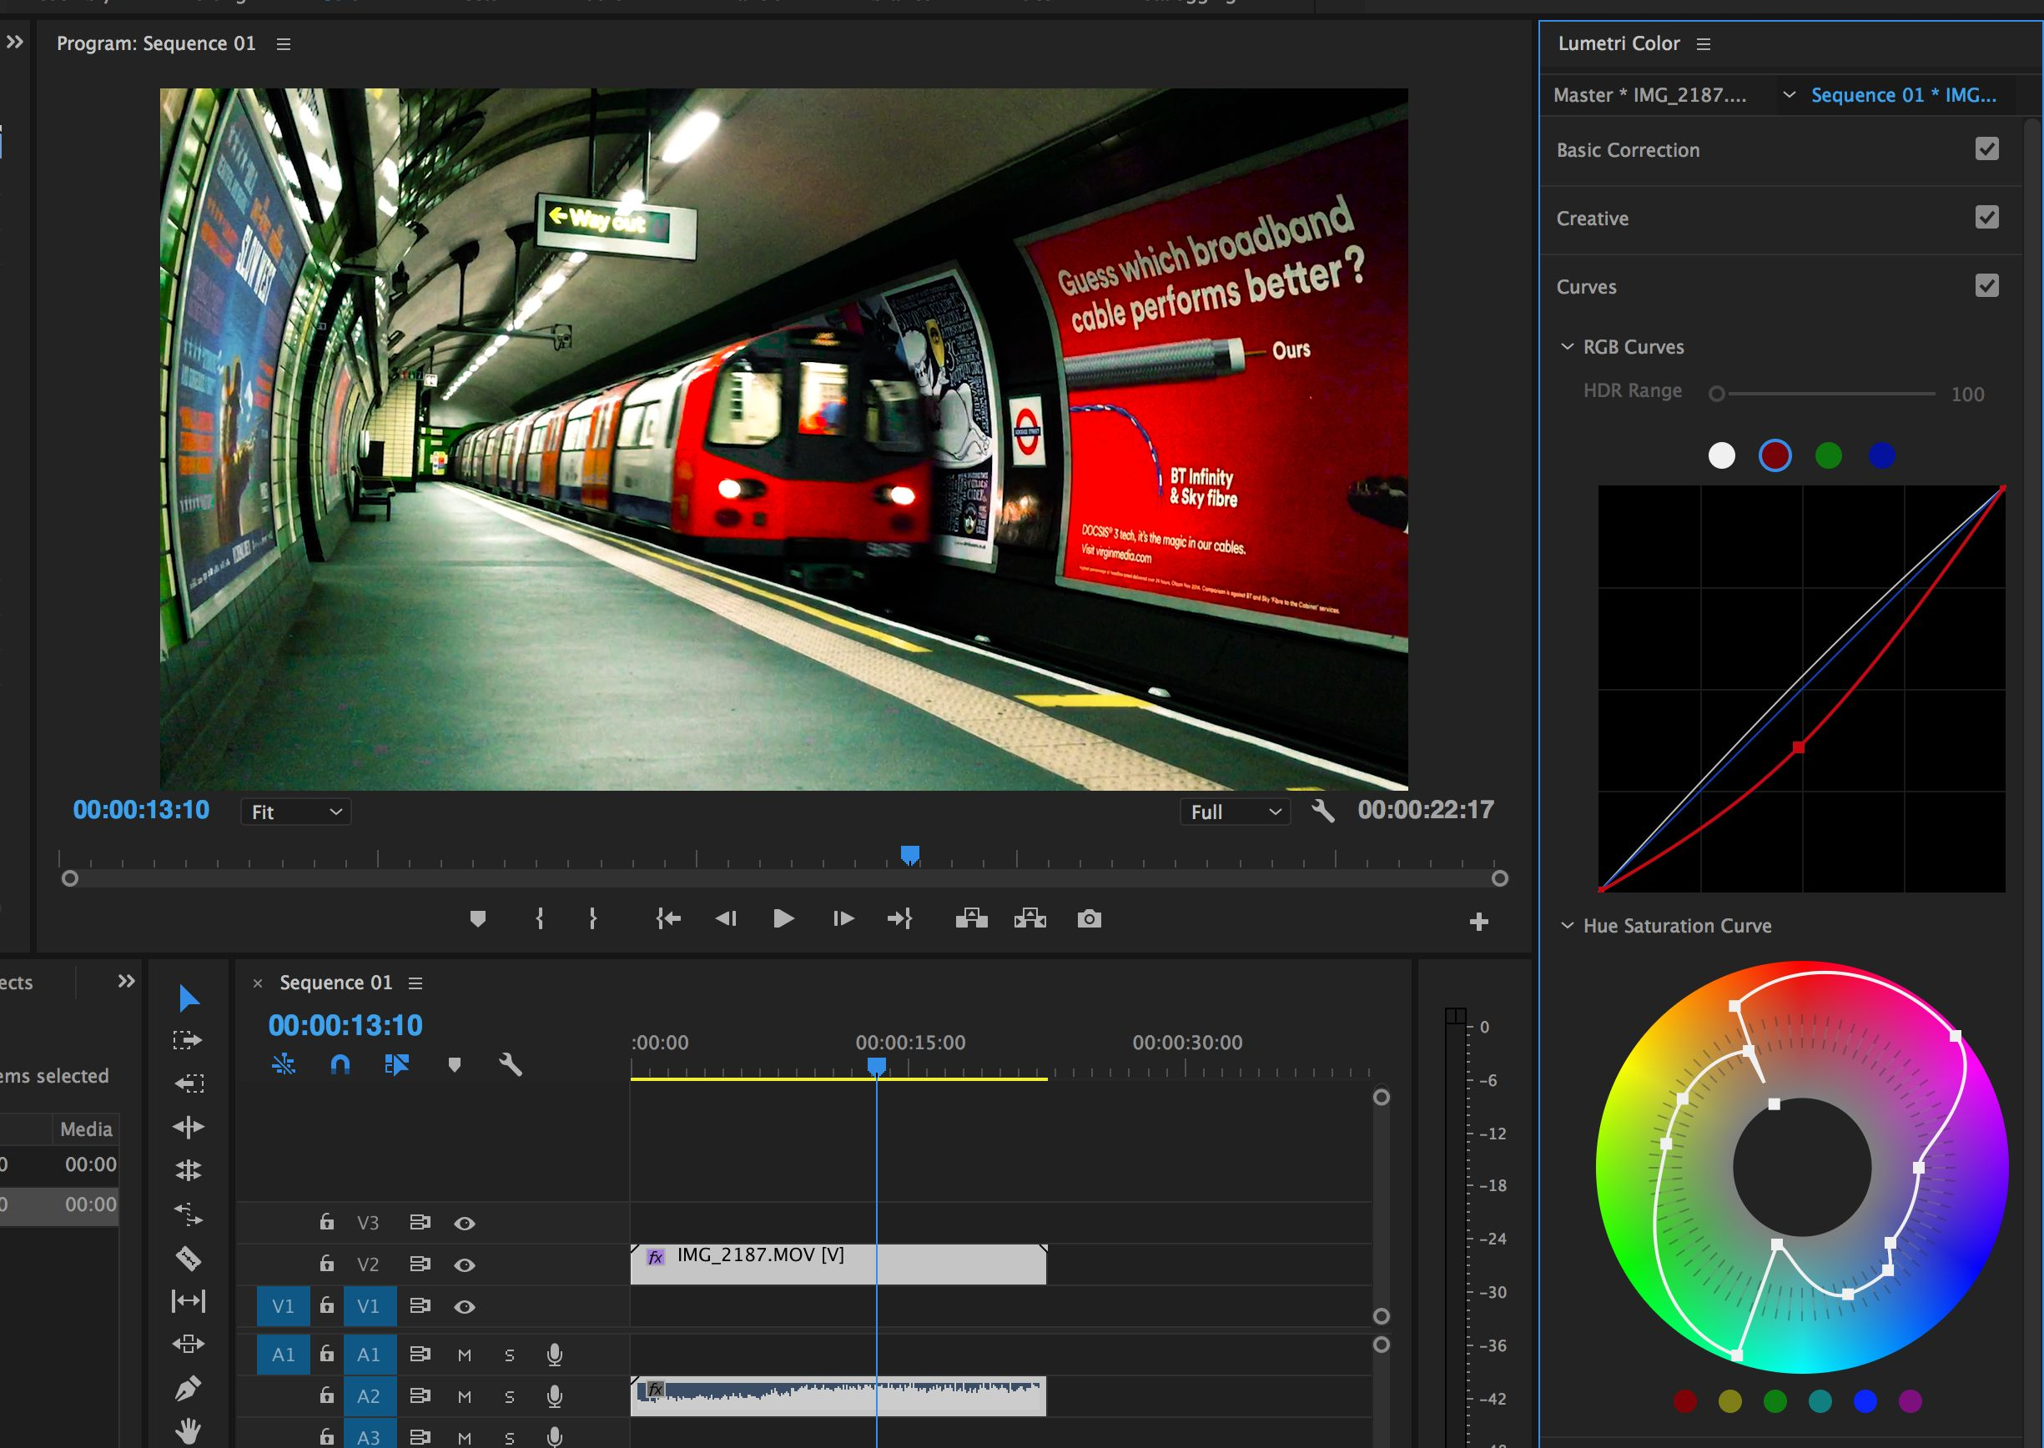
Video Laboratory Overview
Court Compilation/Presentation
Chronological
Compilation
Train footage
Restaurant footage
Shop footage
Notes:
Multiple sources ingested and conformed for editing
Edited on the same timeline
Exported as an MP4
Complex multimedia cases aided by in-house presentation team

Slide 13
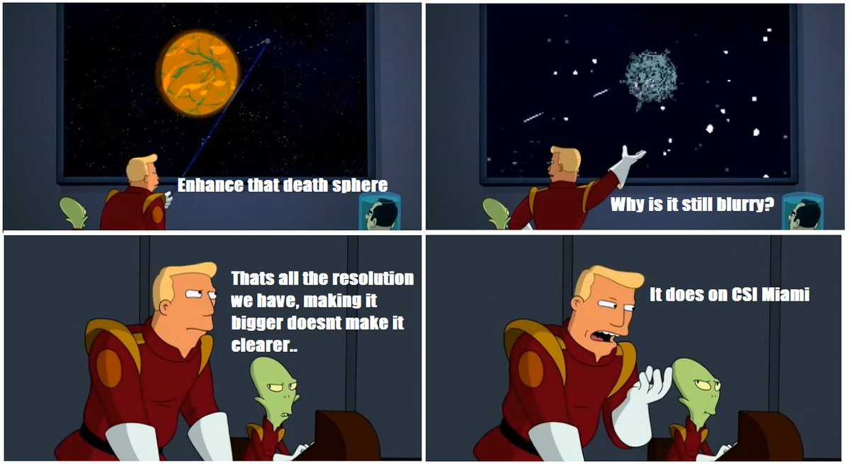
Video Laboratory Overview
Enhancement
Notes:
A mixture of impossible requests,
Wasted hours
Occasional completely amazing results.

Slide 14
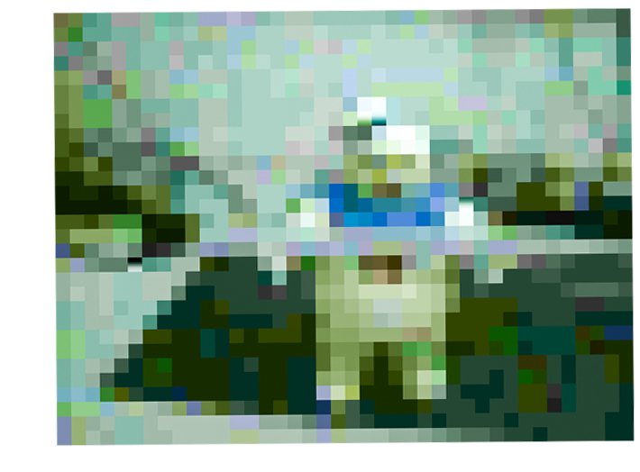
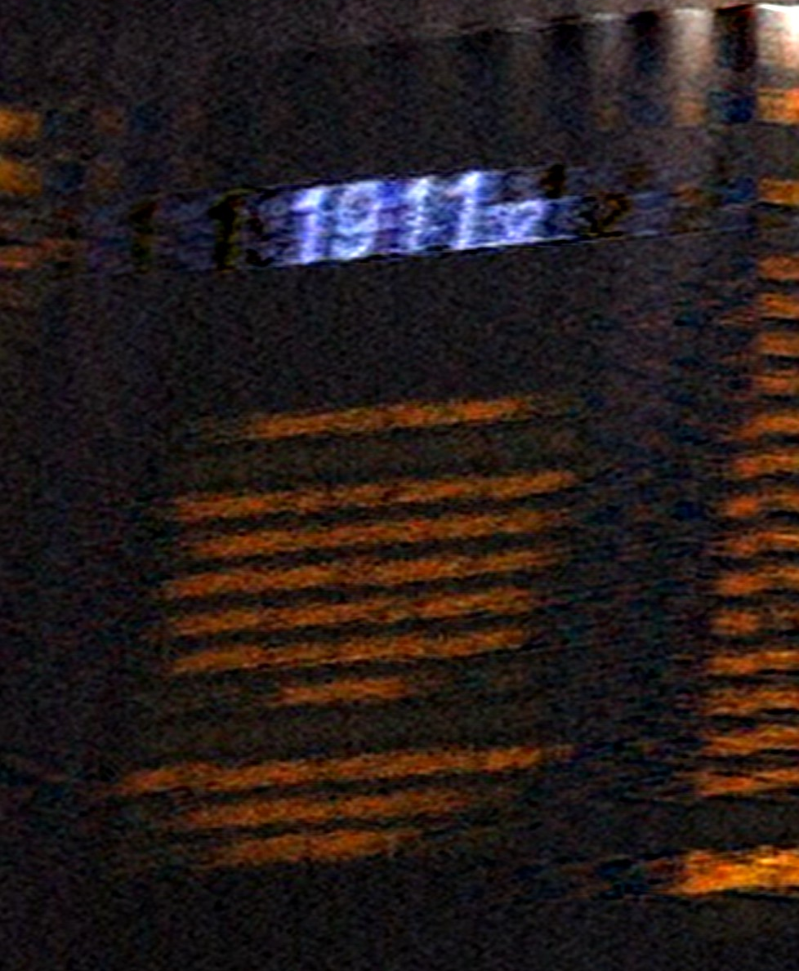
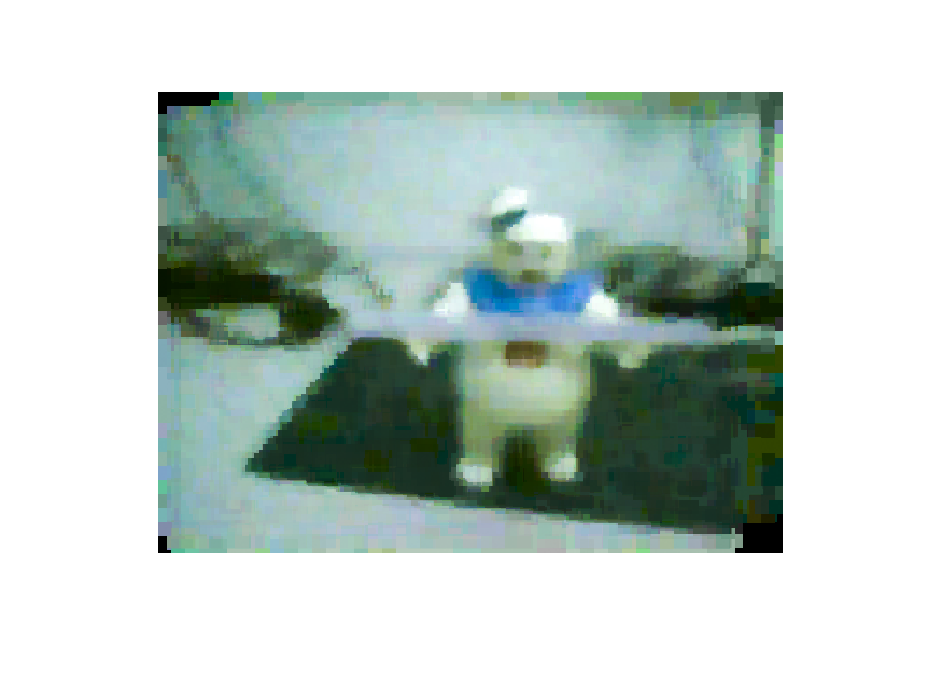
Video Laboratory Overview
Enhancement
Blind Deconvolution
Frame Averaging
Notes:
Blind Deconvolution – compensating for motion blur
Frame stacking – Taking multiple images, aligning and taking an average

Slide 15
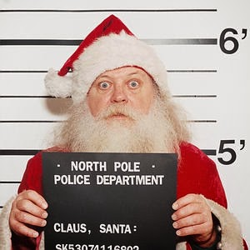
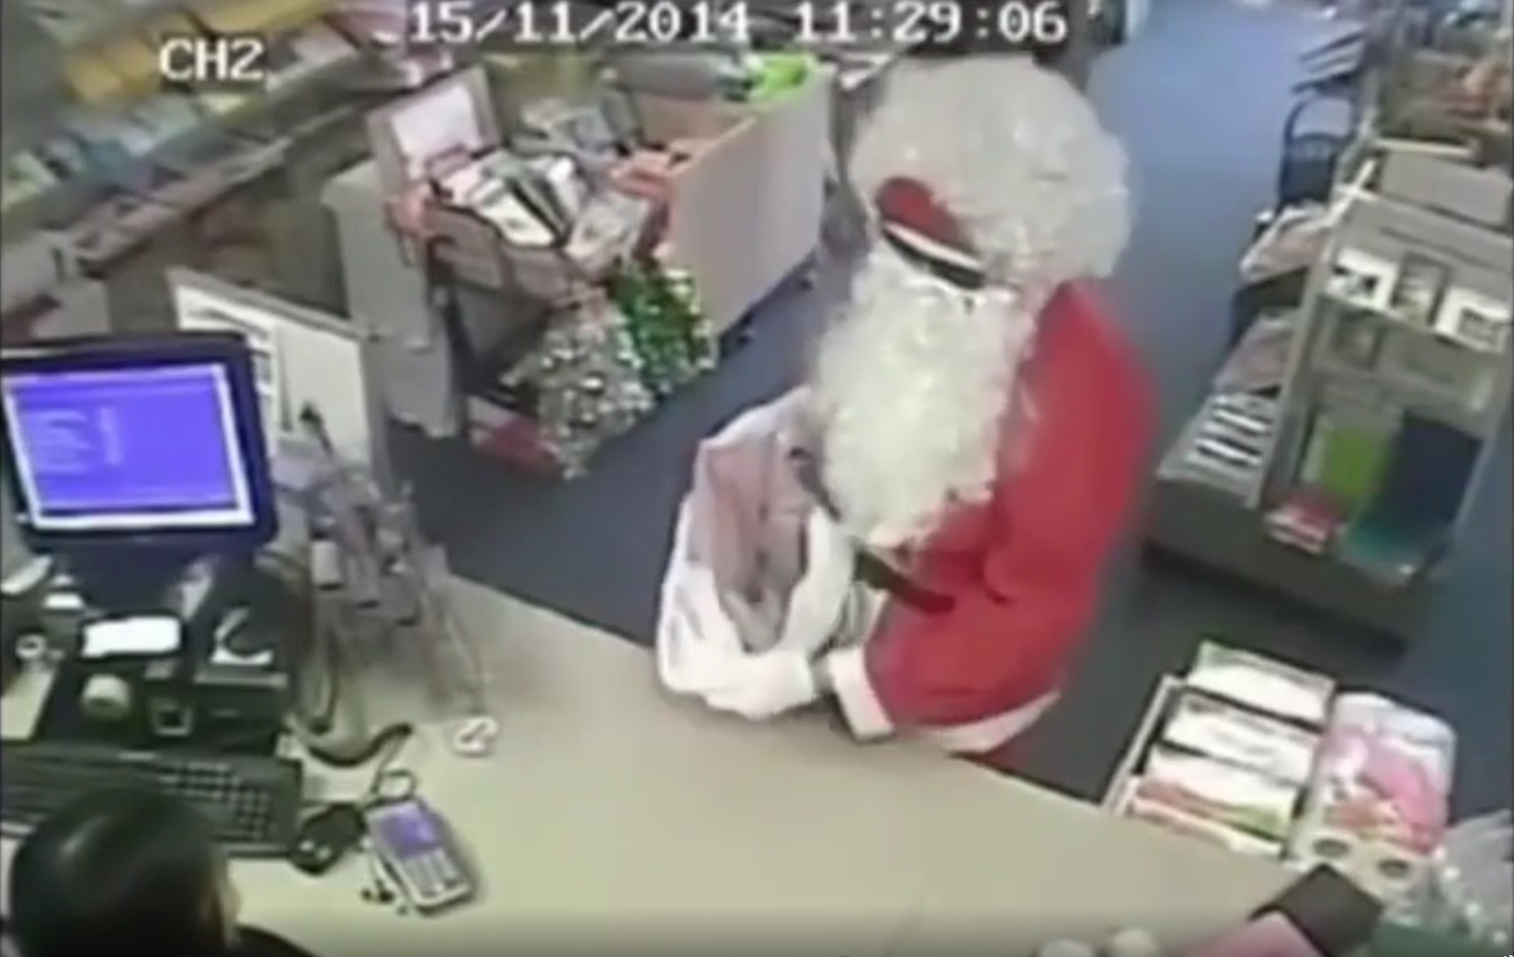
Video Laboratory Overview
Comparison
Clothing
Facial
Objects
Notes:
Taking a reference image to compare to a source clip

Slide 16
Video Laboratory Overview
Overview
Downloads
Source Device
Extraction
Enhancement/ Comparison
Extracted Video
Processing
Court Compilation
Multiple Extracted Videos
Ingest/Editing
Review/ Processing
Review/ Report
Court Presentation
Notes:
Nothing useful found
e.g. 8 hrs of infrared lit spiderweb
OR
Unrecoverable

Slide 17
Diversity of source and format
Gareth.Harbord@met.police.uk

Slide 18
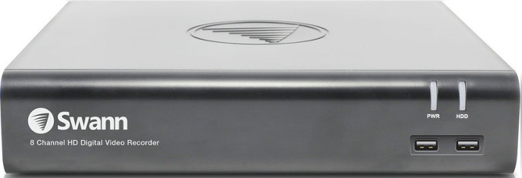
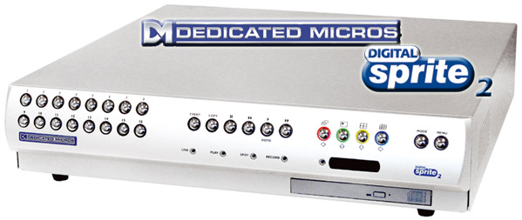
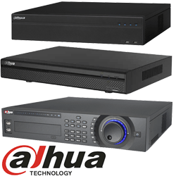
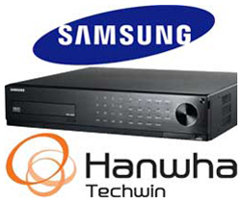
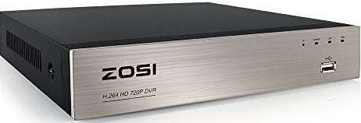
Diversity of Source and Format
CCTV Systems
IP Cameras
Network Video Recorder (NVR)
Digital Video Recorder (DVR)
Notes:
600,000 cctv cameras in London
IP Cameras may use own storage
Hundreds of Network Video Recorders
Hundreds of Digital Video Recorders
Mixed resolutions
Huge variation in quality
Some systems very buggy
Proprietary replay software – more on this later

Slide 19
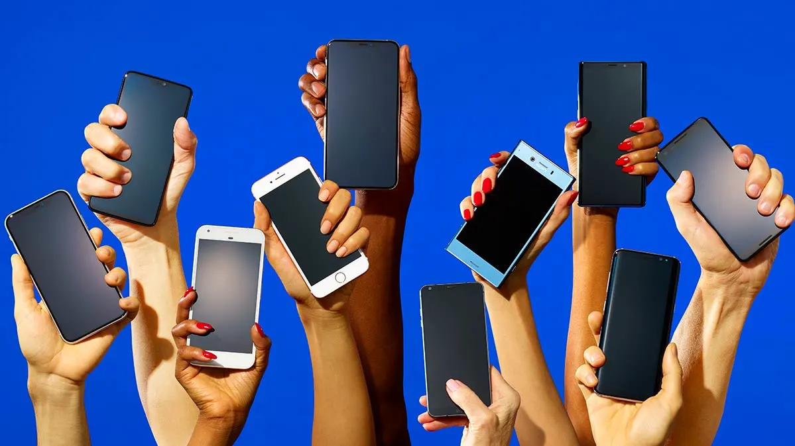
Diversity of Source and Format
Mobile Devices
Notes:
Range issues – clipping limited/full
Mixed resolutions
Variable frame rates
Shakey images – stabilisation
E-mail/Whatsapp/Social Meida compression – Use originals!

Slide 20
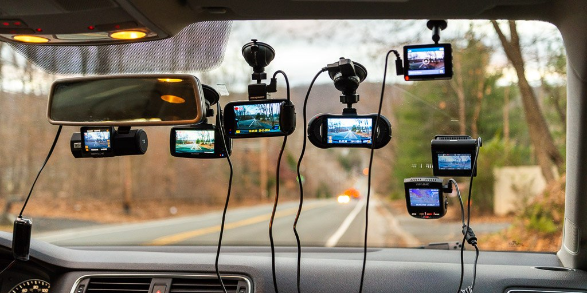
Diversity of Source and Format
Dashboard Cameras
Notes:
Metadata can vary in complexity
Proprietary replay software/formats
Damaged SD Cards

Slide 21
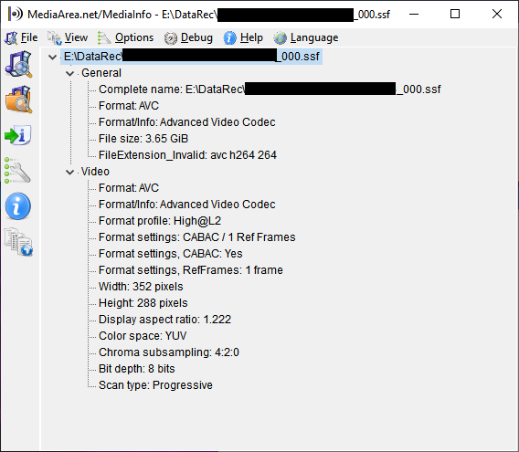
Diversity of Source and Format
Diagnostic Tools Essential!
MediaInfo
FFProbe
ExifTool
https://mediaarea.net/MediaInfo
Notes:
Mediainfo very useful for quick triage of files.

Slide 22
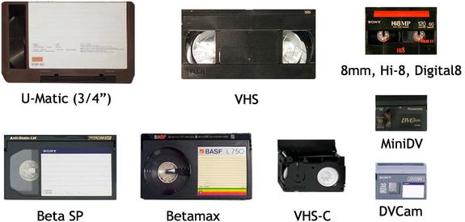
Diversity of Source and Format
Legacy analogue formats
Notes:
Lots of old formats to contend with.
Main difference =
Old multiplex VHS tapes – proprietary demultiplexers

Slide 23
Diversity of Source and Format
Proprietary codecs
Proprietary file systems
Proprietary media containers
Proprietary replay software
Unpredictable data integrity
Notes:
Lots of complexity
Proprietary systems
No/Limited documentation

Slide 24
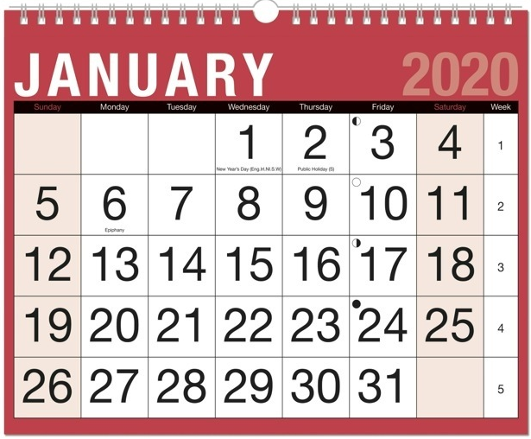
Quantity Not Quality
A 2TB CCTV system may contain 28 days of video
Notes:
Systems are typically configured to record for 28 days

Slide 25
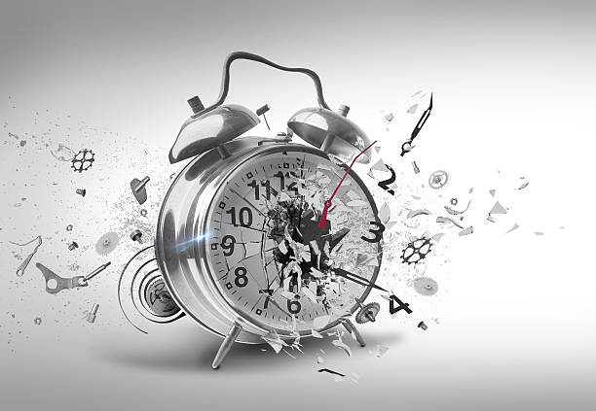
Quantity Not Quality
28 days * 8 cameras = 5,376 hours!!!
5,376 hours on 2TB = 400 kb/s video
Notes:
5000+ Hours of video, multiple cameras.
Must be viewed to reduce requirements
Need short clips -> practical processing.

Slide 26
Quantity Not Quality
Compression at 400 kb/s for HD imagery
400 kb/s
ORIGINAL
Notes:
HD at 400kb/s defeats the point of HD.
Low consumer understanding of bitrate/optics.
Awful.

Slide 27
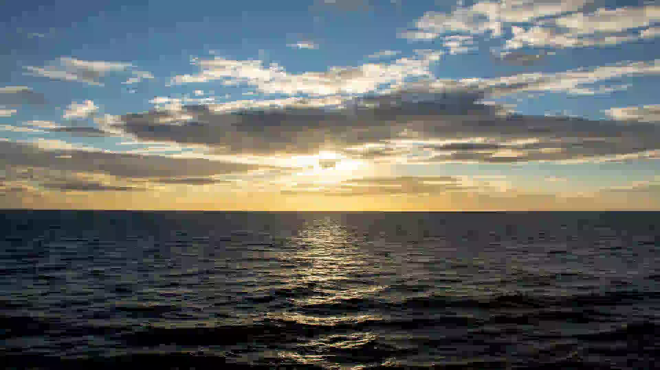
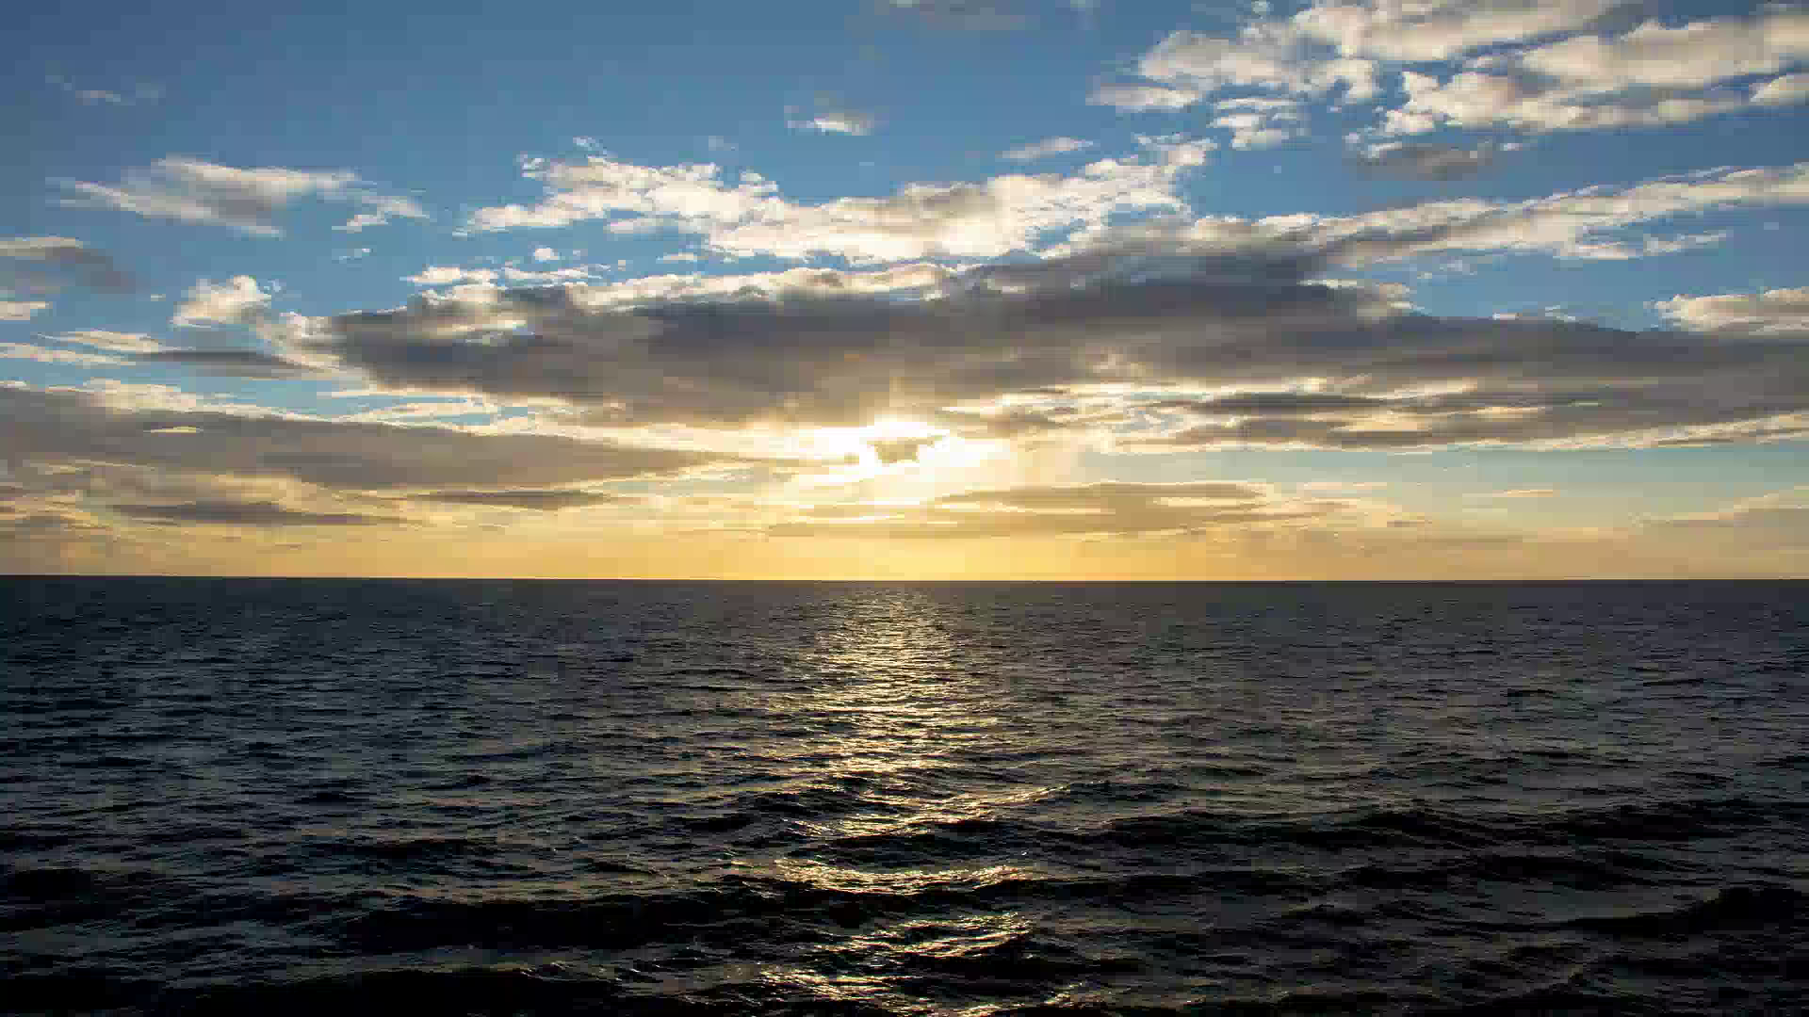
Quantity Not Quality
Bitrate Battles
200 kb/s
400 kb/s
800 kb/s
2000 kb/s
4000 kb/s
Notes:
Hours of video, multiple cameras. Must be viewed -> reduce requirements -> short clips for processing practical.
Ideally 2000+ kb/s
Luck of the draw – bitrate could be any of these

Slide 28
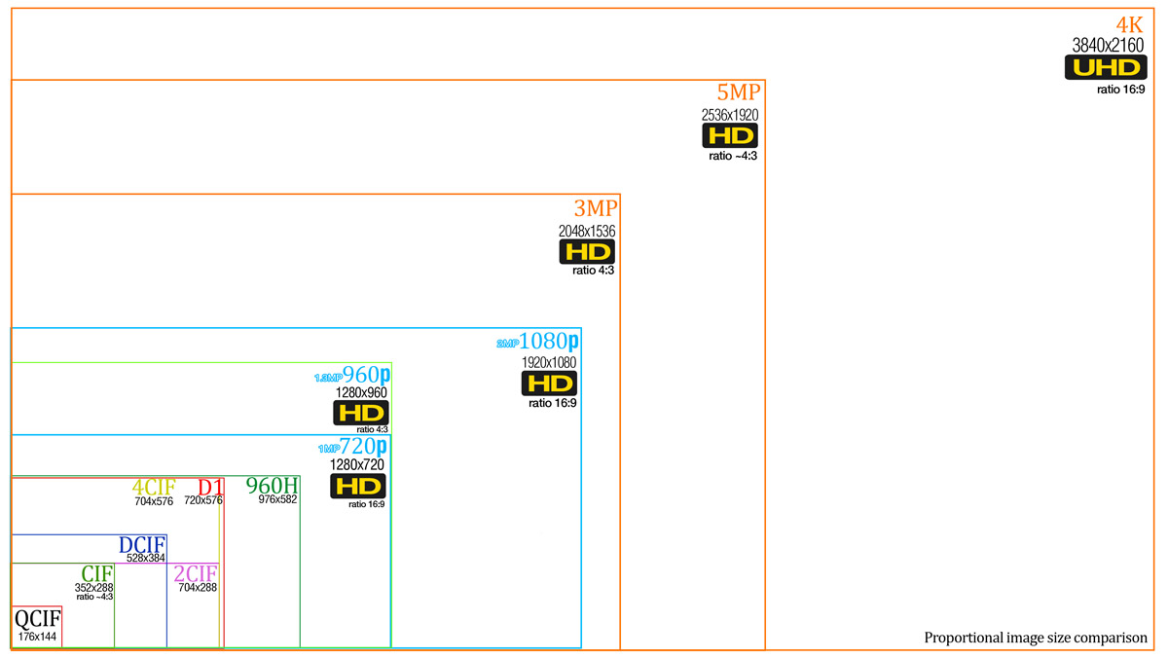
Quantity Not Quality
Resolutions
CIF (352*240)
→
4K (3840*2160)
Notes:
Complete mix of resolutions
All seen regularly

Slide 29
Quantity Not Quality
Relevant data must be targeted
Can’t keep everything
Drive clones made by exception
Quality of source varies greatly
Constantly overwriting
Notes:
May be dealing with 40+ individual items per job
Cloning impractical – only for data recovery
Huge variation in sources
Constantly overwriting – must be secured quickly

Slide 30
Acquisition
Gareth.Harbord@met.police.uk
Notes:
Extracting data from a source device

Slide 31
Acquisition
Officers try at level 1
VIIDO try at level 2
Video Lab at level 3 – toughest 5%
CCTV presents the biggest challenge
Hundreds of proprietary file-systems
Few dedicated extraction tools
Notes:
Officers > Specialist Officers > Video Lab 5%
CCTV is the toughest to acquire of previous sources
Dedicated extraction tools limited/young products

Slide 32
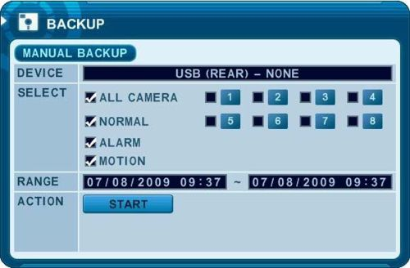
Acquisition
No format standardization
Work on the live device
Disable overwrite
Native or wrapped?
Is it there?
Notes:
Write blocking not possible with DVRs.
Download via USB interface.
Lots of options – Native files usually preferred – with a lot of caveats

Slide 33
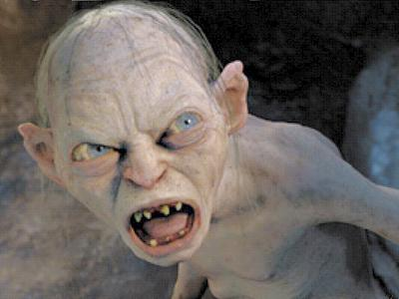
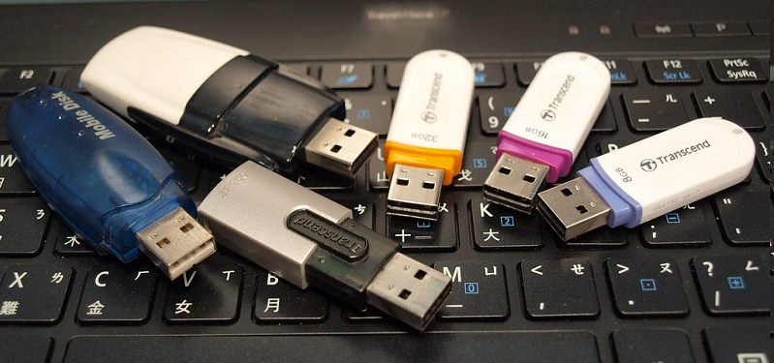
Acquisition
Legacy hardware can require legacy peripherals
Hoard your old USB sticks! <2GB
Notes:
Downloads have moved away from optical discs to USB for newer systems.
Smaller USB sticks more likely to work with older systems.
Keep them nearby!
Can make dealing with long periods impossible.

Slide 34
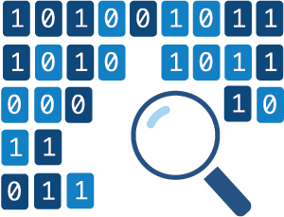
The Broken Ones
Most content sent to the lab is inherently hard to work with.
Fixes can involve reverse engineering and code generation.
No single solution.
Notes:
If it’s been sent to the lab, one or two people have already tried.
Generally people are getting more proficient so the recovery jobs are more consistently difficult.
Fewer easy wins

Slide 35
Acquisition
Read media through a write-blocker
Notes:
Disks should be connected through write blockers
Essential for data preservation

Slide 36
Acquisition
H264 SPS/PPS
Use a hex reader
Notes:
View the disk contents through a hex reader
Look for codec data
Examine nearby headers for repeating structures/markers
0x00 00 00 01 is used in DVR headers causing decoder issues

Slide 37
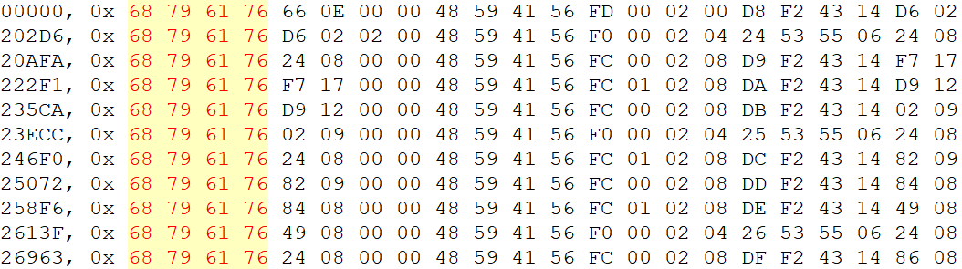
Acquisition
Size?
Camera?
Collect Samples
Notes:
Samples bytes based on the repeating markers
Align the data in order to look for patterns
Test a frame in ffmpeg – look for On Screen Info – Time/CamNo
Increasing numbers might be timecode
Single values – channel number – 3?
Varying 2 or 4 byte values could be a frame size

Slide 38
Acquisition
Lots of notes!
Notes:
This is a section header from an unbranded DVR
Values identified as Little Endian by decoding sampled data
e.g. size of a frame –
take start to end of possible frame >
find a closely matching number in the bytes >
test against the next frame until confidence can be built.

Slide 39
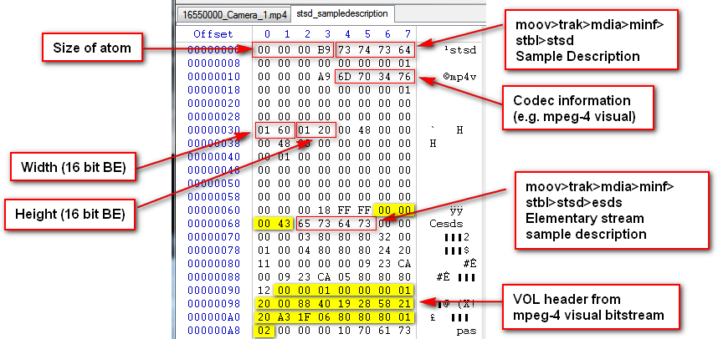
Acquisition
Notes:
Rebuilding damaged MP4s can be complex.
The mdat/media data was missing an index.
Frame starts had to be remapped so the file could be replayed

Slide 40
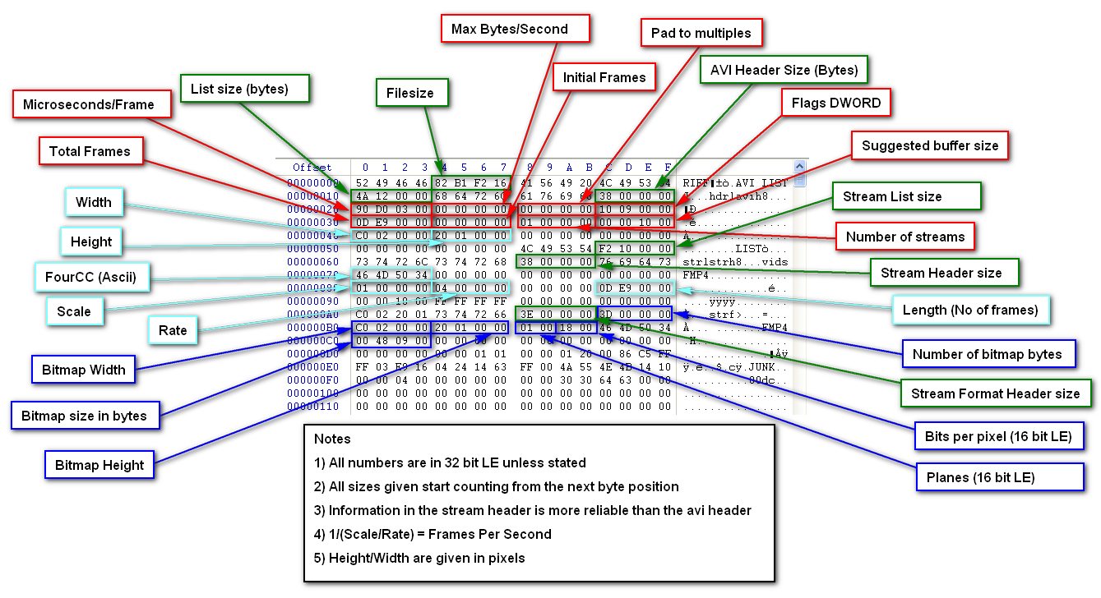
Acquisition
Notes:
This is an AVI header.
It’s amazing just how much information can be stored in such a small space.

Slide 41
Acquisition
Find the footage
Notes:
Once the data is understood, scan for timestamps – using in-house code
i.e. find marker, skip X bytes, decode timestamp, find next marker….
Last scan of a 4TB disk produced a 27GB CSV(!!!) - containing all the decoded timestamps.
Results filtered down to relevant dates so can be targeted.
Slow process

Slide 42
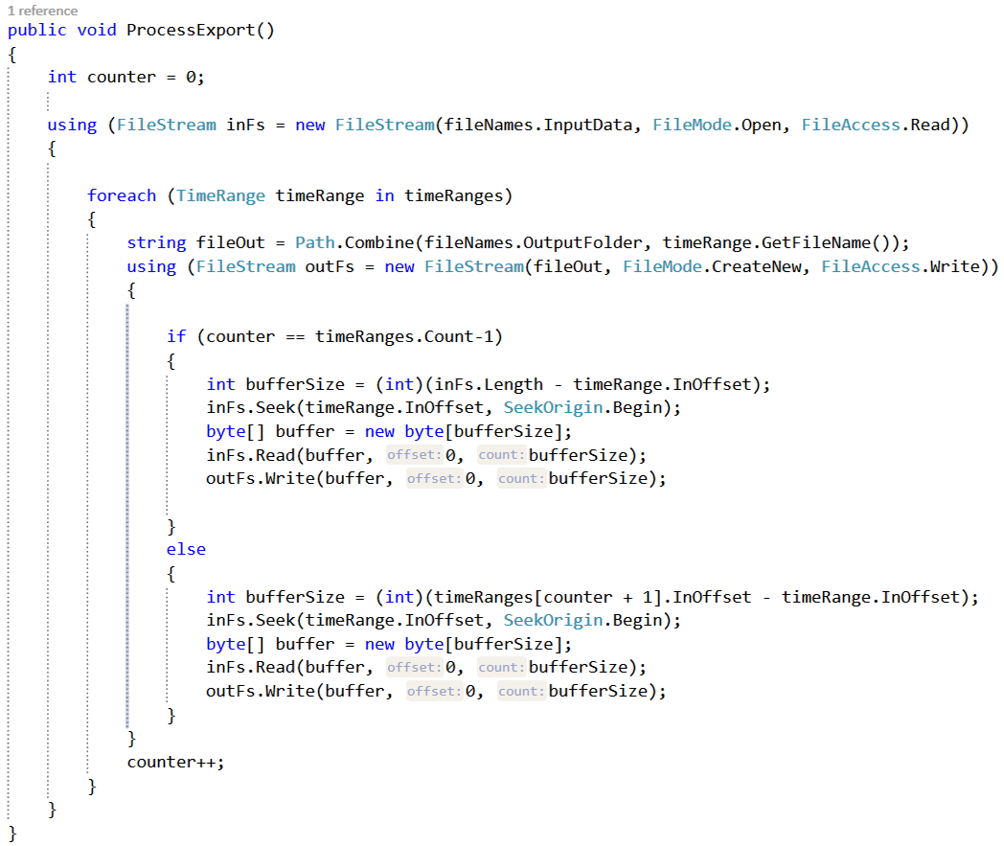
Acquisition
Write some code
Notes:
Once the section of interest found the general file system structure needs to be considered.
May take a few attempts to get right.
Currently using C#
Not great for direct disk access, using raw dd images rather than clones.
Raw frame output then rewrapped through ffmpeg.
Audio adds complexity.

Slide 43
Ingest
Gareth.Harbord@met.police.uk

Slide 44
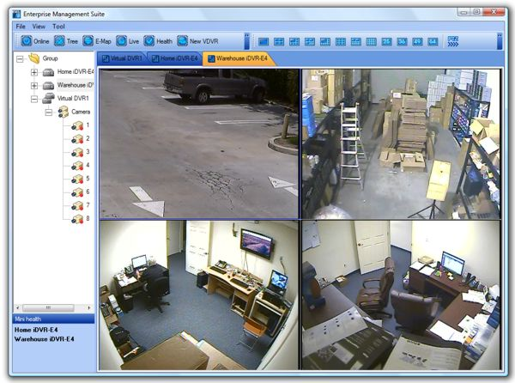
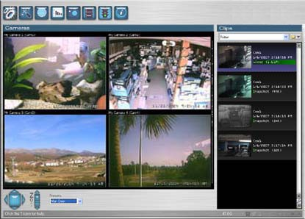
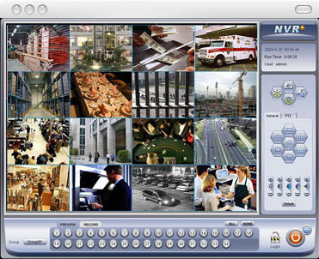
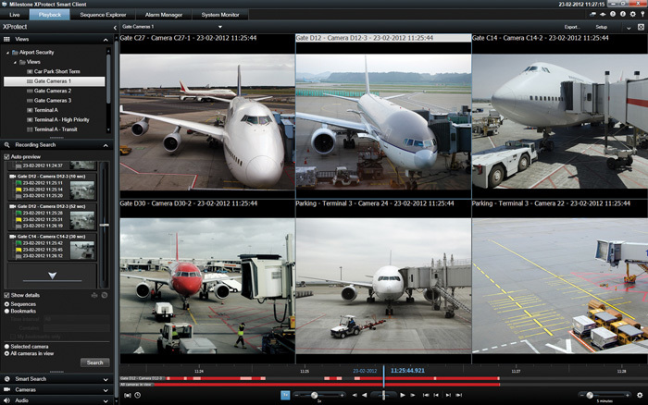
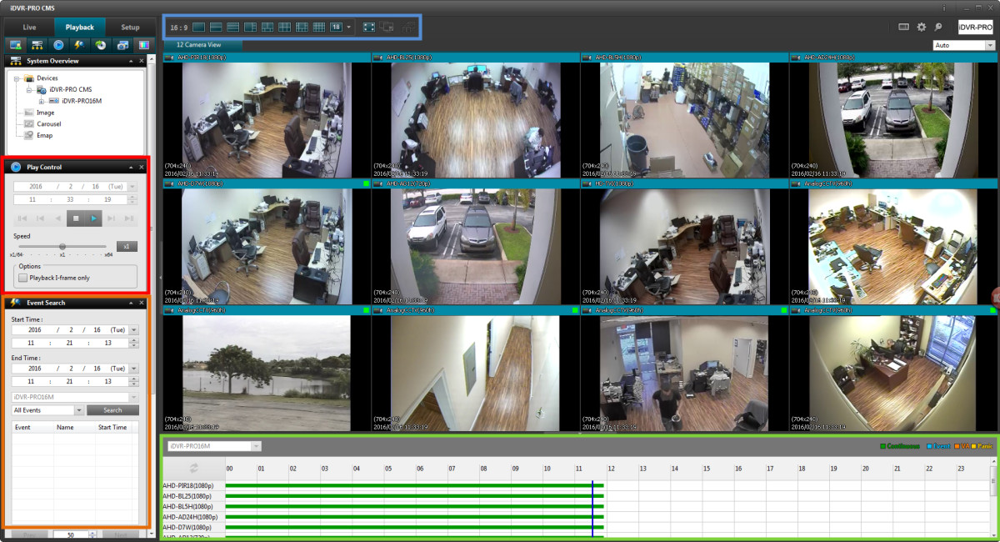
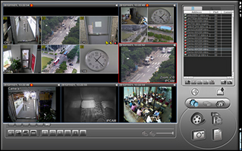
Screen Capture
Notes:
So much replay software!!!
Very idiosyncratic
Buggy – frequent crashes
Limited/Unpredictable Export
Junk system codecs – DirectShow
OS Dependency e.g. XP only players

Slide 45
Screen Capture
CCTV exports in proprietary containers.
Legacy systems used more exotic codecs e.g. ADV601, GEOX, SMAC-M…
Difficult to transcode.
Notes:
Why screen capture?
Some hard to transcode without extraction via data recovery
Screen capture - capturing directly from the player

Slide 46
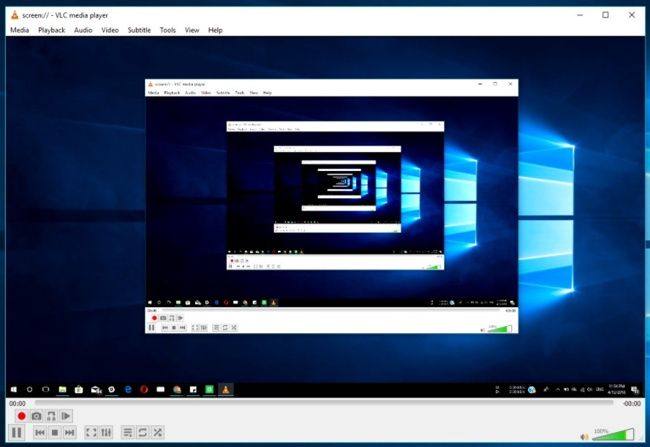
Screen Capture
Proprietary player
Rendered on desktop
Screen
Grabbed
Captured as Raw RGB
Notes:
Most footage start as yuv420
Rendered RGB > Captured as RAW RGB

Slide 47
Screen Capture – Pros
Simple process
Limited technical knowledge required
Native player may display time and date as an On Screen Display (OSD) overlay
Notes:
Overlays will be lost when transcoded - generated within the player

Slide 48
Screen Capture – Cons
Unavoidable colour space conversion i.e. YUV420 -> RGB24
Dropped frames/Scaling issues
Endless executables
Real-time capture
Requires transcoding to conform frame-rates/reduce data size
Notes:
Dependent on flawed binaries/executables
Clipping from RGB conversion
Real time
Still needs transcoding for conformance

Slide 49
Transcoding
Native file e.g CAM1.DAV
FFMPEG
Lossless H264
Notes:
Native file
Straight into FFMPEG – sometimes forced flag required
Libx264 Lossless MOV

Slide 50
Transcoding - Pros
Maintain colour space/less vulnerable to clipping
Less likely to crop image edges
Better with interlaced sources
Faster than real-time
No executable
Notes:
Colour space changes lead to clipping i.e. full range -> limited range
Avoid player cropping/scaling edges of video
Filters like yadif for de-interlacing available
Faster than realtime
System is kept cleaner – less junk executables

Slide 51
Transcoding - Cons
Not all formats compatible
OSD overlays cannot be captured
Unpredictable behaviour
Timing can be lost
Notes:
More complexity
Manufactures throw specs to the wind and use mpeg start codes
Higher risk of artefacts
No OSD - timestamps

Slide 52
Rewrapping
Ideal for enhancement
Sometimes pre-transcode
Trial and error involved
Timecode repair
Notes:
Rewrapping can be useful for a variety of situations
e.g. a codec not playing back in AVI might perform better in MP4.
Can help with timing issues when timing can’t be detected in original – can help if seeking required in a large clip

Slide 53
Ingest
Currently using 8-bit libx264 lossless as intermediate format
Video conformed to 30fps
Scaled to 1920*1080
Mastering to DNX MOV
Distributing as MP4 via ffmpeg
Notes:
The end goal of ingest is to have a video conformed for editing or enhancement.
The edit workflow currently requires a 30fps clip, 1080p clip encoded to libx264 8-bit lossless. Previously we were using ProResHQ.
Enhancement generally best done directly on the original or a rewrapped version of the original.
Chapter markers difficult to retain.
General trend away from menus.
Replay in browsers unpredictable.

Slide 54
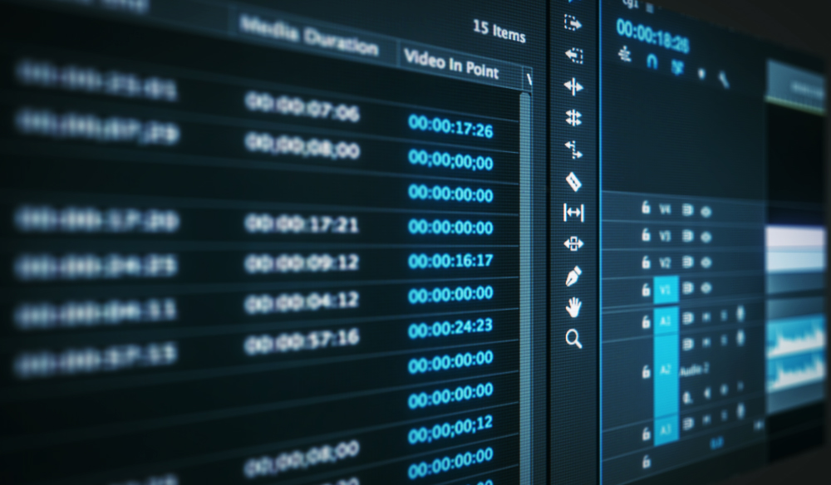
Presentation
Court replay systems problematic
Wireless streaming degrades replay
Presentation team educate officers
In-house presentation software
Notes:
Wireless display dongles are bad news – live, on-device encoding
Unpredictable results.
Hard to control what happens once items leave the lab.
Presentation team have software – Focus 3 for multimedia/complex cases.
Spend time training officers on using the equipment before going to court.

Slide 55
Questions?
Gareth.Harbord@met.police.uk

Slide 56
Editing
Gareth.Harbord@met.police.uk

Slide 57
Editing
May edit clips from CIF to 4K on same timeline.
Using a 1920*1080 timeline
Video ordered chronologically
Highlighting sometimes required
Avoid adding titles
Notes:
On to edits…
Currently using a 1080p timeline to match the displays in the court.
Decided better scale during the edit that let the displays do it internally.
Highlighting can be difficult when dealing with low frame rate sources – interpolation issues
Titles turn edits into infinite boomerangs

Slide 58
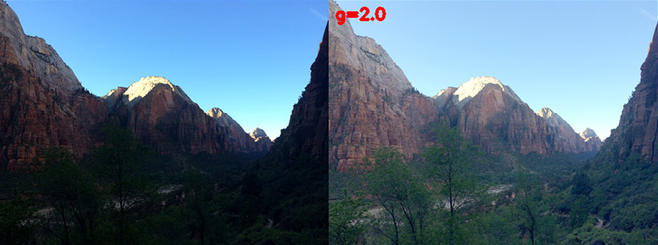
Editing
Adjustment
Light levels/Gamma
Notes:
Grey line between editing/enhancement
Presentation type filters
Light levels/Gamma
Careful to avoid YUV clipping – few vendors label their bitstreams correctly!
Avoid colour adjustment

Slide 59
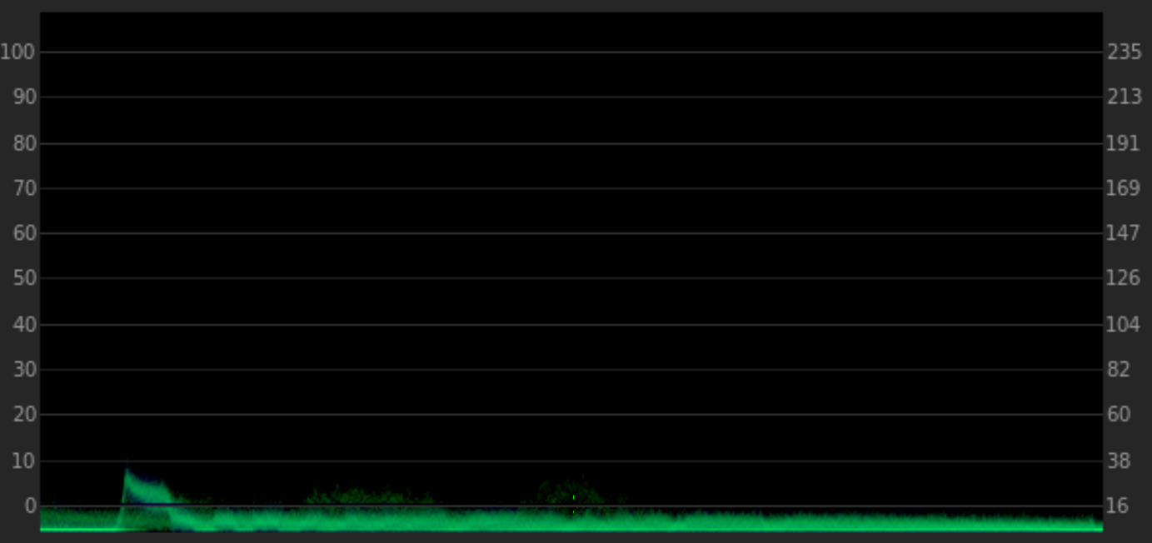
Editing
Adjustment
Light levels/Gamma – Use a waveform monitor
Notes:
Careful to avoid YUV clipping – few vendors label their bitstreams correctly!
The waveform monitor is the best way to identify out of range values.

Slide 60
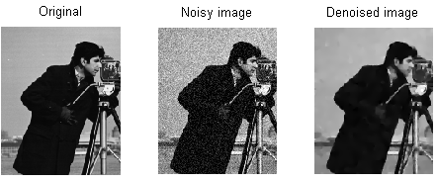
Editing
Adjustment
Noise Reduction
Notes:
Grey line between editing/enhancement
Presentation type filters
Denoise – Using filters such as NEAT Video

Slide 61
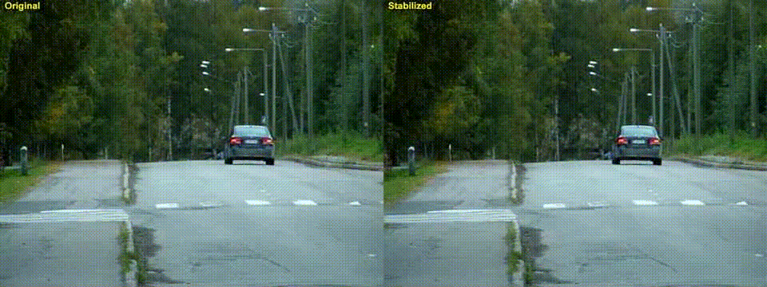
Editing
Adjustment
Stabilization
Notes:
Grey line between editing/enhancement
Presentation type filters
Stabilization – Remove distractions from shakey video
Avoid colour adjustment

Slide 62
Editing
Timeline mastered as DNX MOV then produced as H.264 MP4
Chapter markers useful
Menu systems all but abandoned
Notes:
Timeline has to be exported as a DNX mov. Then encoded to h.264 using ffmpeg to preserve chapter markers
Modern players have moved away from dvd style menus.

Slide 63
Enhancement
Gareth.Harbord@met.police.uk

Slide 64
Enhancement
Blind Deconvolution
Notes:
Enhancement:
Advanced deblurring techniques
Can be used to correct for motion blur

Slide 65
Enhancement
Frame Averaging
Notes:
Enhancement
Frame averaging involves aligning then stacking frames
Taking the average can create an image with less noise/compression artefacts

Slide 66
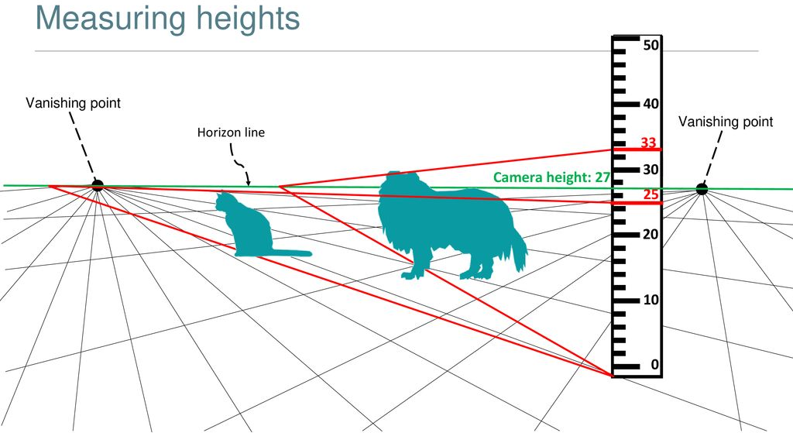
Enhancement
Photogrammetry
Notes:
Enhancement
Photogrammetry
Using a reference object and vanishing points to calculate the height of an object in an image.
Requires subjects with known heights to stand in the scene – increase confidence in results.

Slide 67
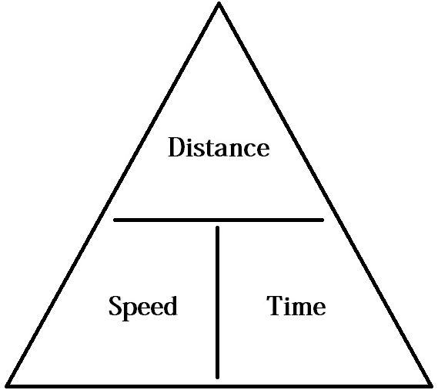
Enhancement
Speed analysis
Notes:
Enhancement
Photogrammetry
Similar techniques can be applied to calculate the speed of a moving object.

Slide 68
Questions?
Gareth.Harbord@met.police.uk

